Slide 1



Movie Recommendation System Using Machine Learning
Tazan Rabbani
193-15-13441
Md. Jahidur Rahman
ID: 163-15-8471
Istiak Ahmed
ID: 193-15-13450

Slide 2
Movie Recommendation System
Content Based Recommendation System
Popularity Based Recommendation System
Collaborate Recommendation System

Slide 3

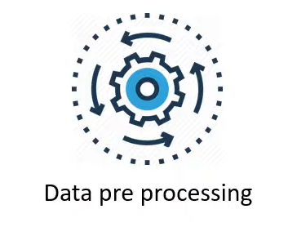
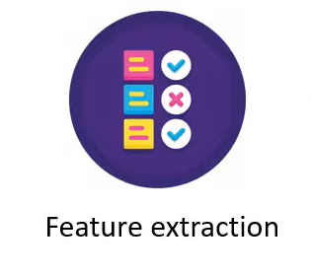
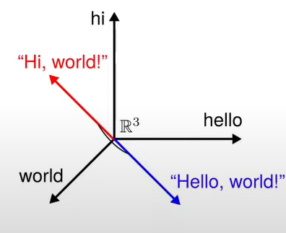
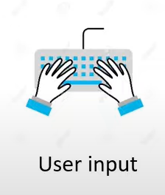
Work Flow
List Of Movie
Cosine Similarity

